Slide 1
Familiarize yourself with phishing attacks
<teams identified as most at risk>
Top At-Risk Teams
Team | Open Rate | Click Rate | Success Rate | Risk Level
HR | 100% | 65% | 75% | 🚨 Critical
Marketing | 65% | 40% | 38% | 🔥 High
Card Services | 60% | 50% | 10% | ⚠️ Moderate

Slide 2
What is phishing?
1. What is Phishing?
2. Why Do Attackers Phish?
3. Common Phishing Methods
4. Red Flags to Spot
5. The Cost of Falling for Phishing
6. Why You’re a Target
7. How to Verify Suspicious Messages
8. What to Do If You Clicked
9. Your Role in Security
10. Real-World Example
Key Takeaway: Phishing works because it looks real. Slow down, verify,
and trust your instincts—if something feels off, it probably is!

Slide 3
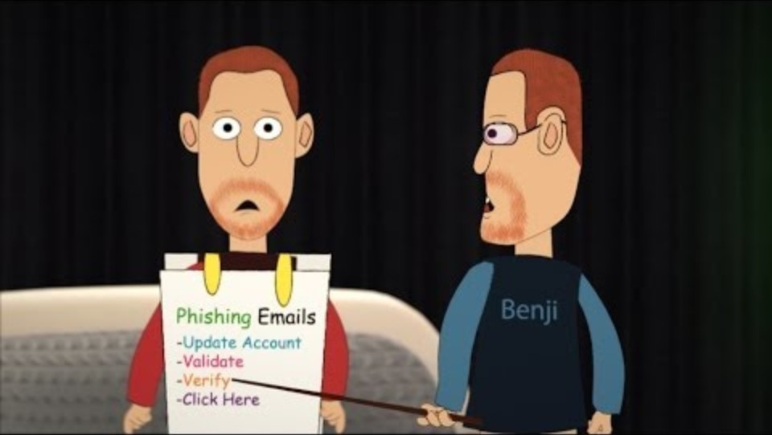
Learn to spot phishing emails
Urgent Action Required "Your account will be suspended in 24 hours! Click here to verify now."
Fake Sender Impersonation "Microsoft Support" no-reply@secure-microsoft.xyz (fake domain)
Too-Good-To-Be-True Offers "You’ve won an iPhone! Claim your prize before it’s gone!"
Fake Invoice/Order Scam "Your recent Amazon order #12345 failed. Click to confirm payment."
Threats or Consequences "Your tax return was flagged for fraud—respond immediately!"
Spoofed Legitimate Links "Click here: www.paypa1-security.com" (misspelled "PayPal")
Request for Sensitive Data "HR Dept: Update your payroll details here."
Bogus Security Alerts "Suspicious login detected! Secure your account now."
Fake Attachments "Invoice_2024.pdf.exe" (malware disguised as a PDF)
Emotional Manipulation "A family member needs emergency funds—wire money ASAP!“

Slide 4
How do we stop getting phished?
Before Clicking or Responding
Check the Sender’s Email – Look for misspellings or strange domains (e.g., support@amaz0n.net).
Hover Over Links – Preview URLs before clicking to see if they match the claimed sender.
Beware of Urgency – Phishing often pressures you ("Act now or lose access!").
Handling Suspicious Emails
Don’t Open Attachments – Especially from unknown senders (.exe, .zip files).
Verify Requests – Contact the company directly (via official website/phone) before responding.
Look for Poor Grammar – Many phishing emails have spelling mistakes or odd phrasing.
Strengthening Security
Enable Multi-Factor Authentication (MFA) – Adds an extra layer of protection.
Use a Password Manager – Helps avoid entering credentials on fake sites.
Update Software Regularly – Patches security flaws that phishers exploit.
Staying Proactive
Report Phishing Attempts – Forward suspicious emails to your IT team or anti-phishing organizations (like reportphishing@apwg.org).
Stay skeptical—phishers rely on haste and trust! 🚨

